Slide 1



Population Explosion (Overpopulation)
Presented By Allahdad

Slide 2
World Population
The world population increased from 1 billion in 1800 to around 8 billion today.
Global population projected to exceed 8 billion in 2022; half live in just seven countries.

Slide 3
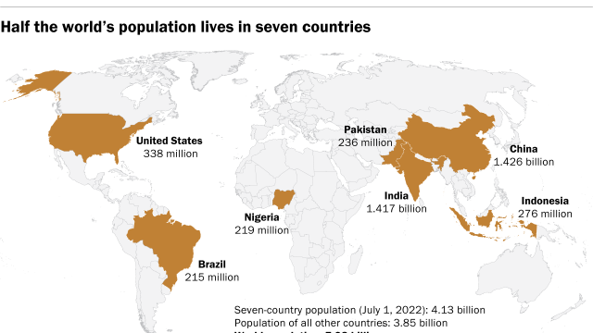

Slide 4
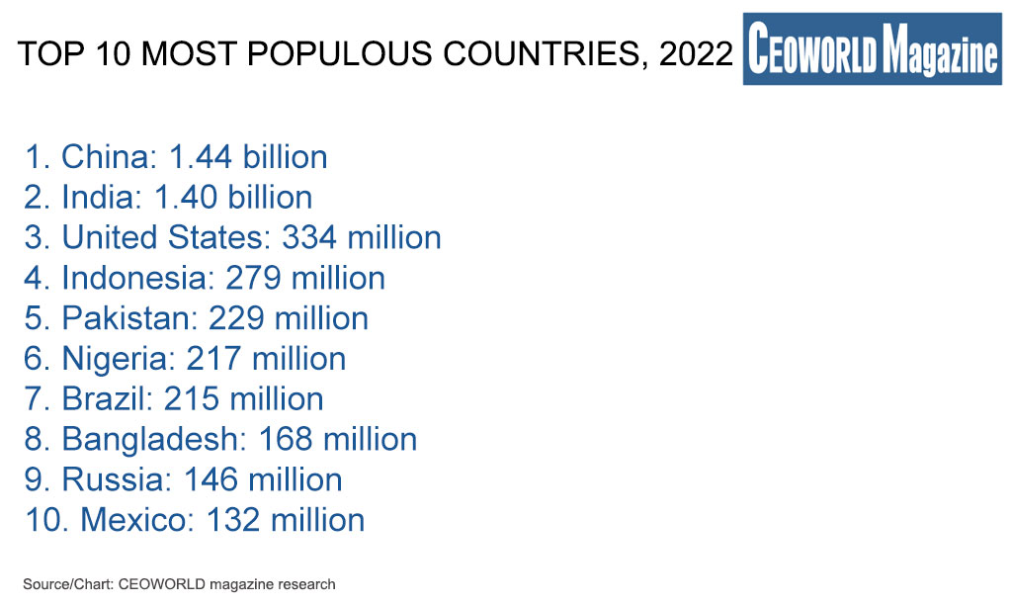

Slide 5
China’s policy to overcome population: policy (1980-2016)
The one-child policy was a program in China that limited most Chinese families to one child each.
It was implemented nationwide by the Chinese government in 1980, and it ended in 2016.
The policy was enacted to address the growth rate of the country's population, which the government viewed as being too rapid.
Result : 400 million births prevented

Slide 6
Policy (2016-2021)
China officially ended its one-child policy on January 1, 2016, with the signing into law of a bill allowing all married couples to have a second child as it attempted to cope with an ageing population and shrinking workforce

Slide 7
Policy (2021-Onwars)
In 2021, China amended its Population and Family Planning Law for the second time in an attempt to increase the birth rate by permitting couples to have three children.
This recent amendment ends nearly 50 years of strict control over births.

Slide 8
India’s population is almost same as China’s
do you ever think that why India’s government is not doing anything to stop it?

Slide 9
Major REASONS:
Politicians
Industries
Lack Of Awareness

Slide 10
Pakistan’s population Overall➔231,214,711
Province | Population
Punjab | 10,99,89655
Sindh | 4,78,54,510
Khyber Pakhtunkhwa | 35,501964
Balochistan | 1,23,35129
Gilgit Baltistan | 12,49000

Slide 11
Top 5 populous City of Pakistan:
# | CITY NAME | POPULATION
1 | Karachi | 11,624,219
2 | Lahore | 6,310,888
3 | Faisalabad | 2,506,595
4 | Rawalpindi | 1,743,101
5 | Multan | 1,437,230

Slide 12
Overpopulation causes
01
OverpopulationEffects
02
Overpopulation Solutions
03

Slide 13
Pakistan: overpopulation causes:
Early marriages,
Increase in birth rate,
Desires for sons,
Polygamy (more than two wives at a time),
No family planning,

Slide 14
Pakistan: overpopulation effects
Limited food supply available,
Poverty,
Unemployment,
Pollution(air, noise, water),
Health problems,
Political instability,

Slide 15
Pakistan: overpopulation solutions
Proper family planning,
Break tribalism system(unnecessary marriages),
Promoting education,
Building more institutes,
Best hospital facilities,
Support women in education,

Slide 16


Slide 17
Thank You....!

